Slide 1
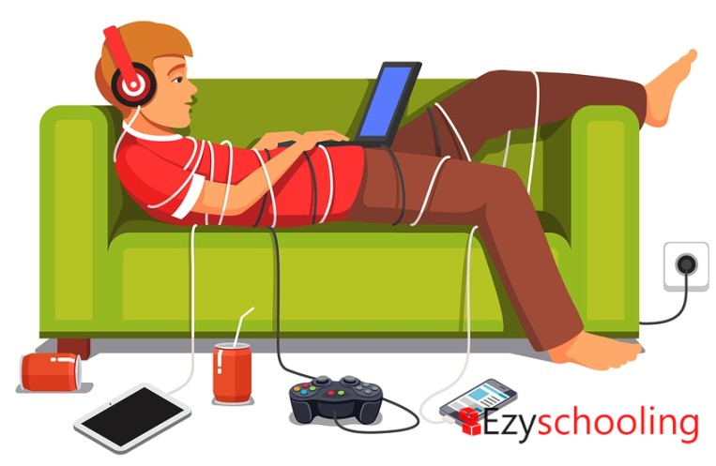
Managing
Digital Addictions
Ms Akanksha Jayant Rajguru
Ph.D. Scholar
AIIMS, New Delhi

Slide 2

To-do
01
02
03
Introduction
Theories of Digital Addiction
Managing Digital Addictions

Slide 3

Digital Addiction
refers to a behavioral disorder characterized by an excessive and compulsive use of digital devices and online activities, to the extent that it interferes with an individual's daily life, work, relationships, and overall well-being
Image retrieved from: http://jimpintoblog.blogspot.com/2016/02/digital-addiction.html

Slide 4
Problematic Smartphone Use
Online Gaming Addiction
Problematic Internet Use
Online Shopping Addiction
Online Gambling Addiction
Social Media Addiction
Cybersex/ Pornography Addiction
Facebook Addiction
Video Game Addiction
Smartphone Addiction

Slide 5
Digital Addictions
Digital Devices
Digital Platforms
Digital Medium
Computer
Smartphones
Digital gadgets
Google
YouTube
Facebook
Internet
Online media/ modes (movies, shopping)
Video Games

Slide 6
Signs And Symptoms
Excessive use
Loss of Interest
Negative impact on relationships
Loss of control
Preoccupation
Withdrawal symptoms
Escapism
Neglected Health
Inability to disconnect
Neglecting responsibility
Tolerance
Financial consequences

Slide 7
Theories of Digital Addiction
Reward-Deficiency Hypothesis
Conditioning
Sensation Seeking
Social Skills Deficit Theory
Cognitive-Behavioral Models

Slide 8
Reward-Deficiency Hypothesis
Achieve less satisfaction (Natural rewards)
Seek enhanced stimulation (Substances/ Digital devices)

Slide 9
Learning: Operant Conditioning
Feeling of happiness
Negative Reinforcement
Reduces boredom
Reduces loneliness
Instant gratification
Behavior repeated
Positive Reinforcement

Slide 10
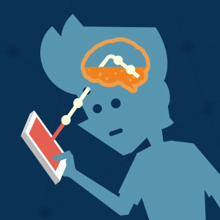
Sensation Seeking
Higher need for stimulation
Bored with repetition, predictable experiences
Increased vulnerability to problematic use of technologies

Slide 11
Social Skills Deficit Theory
Poor social competence
Anxious social interactions
Less threatening interactions + Anonymity

Slide 12

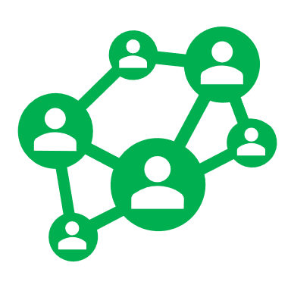



Cognitive-Behavioral Model
Situational cues (e.g. boredom, loneliness, social isolation. Lack of social support, uncertainty)
Behavioral symptoms
(e.g. Excessive use; no longer enjoying activities that were once enjoyed;
anger/ agitation when separated; lying about/ concealing use)
Obsessive thoughts
Fewer positive feelings about oneself when offline a.c.t when online.
  Short terms thinking
  Rumination
  All-or-none thinking
Maladaptive Cognitions
Digital Addiction
Existing psychopathology (e.g. depression, social anxiety, impulsivity, substance dependence)

Slide 13
Cognitive-Behavioral Model
Situational cues (e.g. boredom, loneliness, social isolation. Lack of social support, uncertainty)
Behavioral symptoms
(e.g. Excessive use; no longer enjoying activities that were once enjoyed;
anger/ agitation when separated; lying about/ concealing use)
Maladaptive Cognitions
Digital Addiction
Existing psychopathology (e.g. depression, social anxiety, impulsivity, substance dependence)

Slide 14

Managing Digital Addictions

Slide 15
Raise Awareness
Awareness
Digital Addictions
Signs and Symptoms
Impacts
Interventions
Web, App or game based interventions

Slide 16

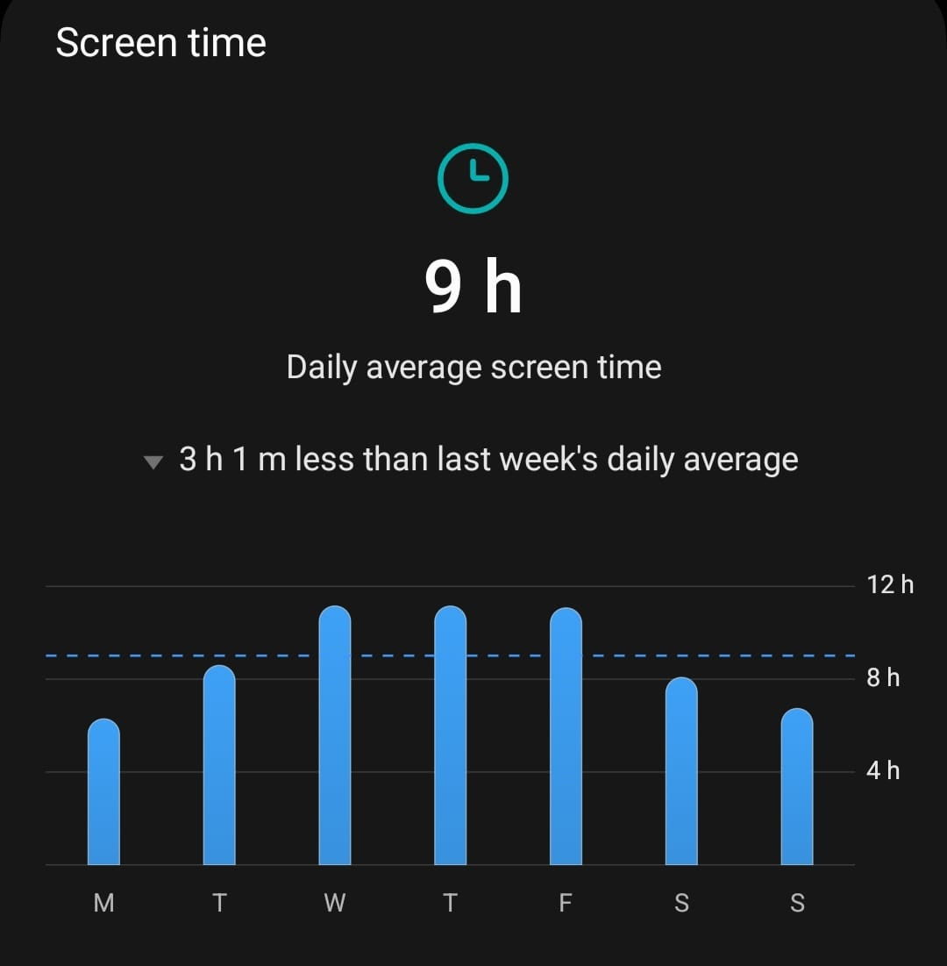
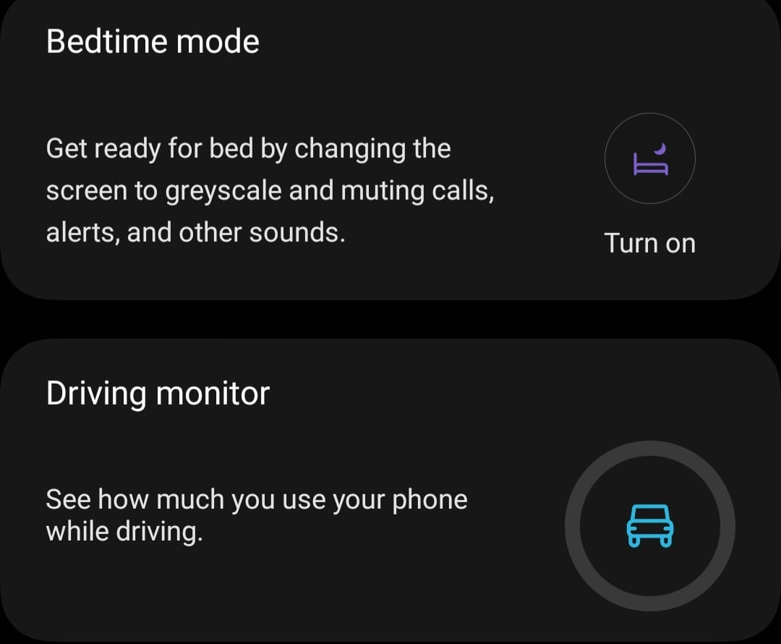
Self Awareness and Monitoring
Digital Wellness Applications
Positive framing
Negative framing

Slide 17
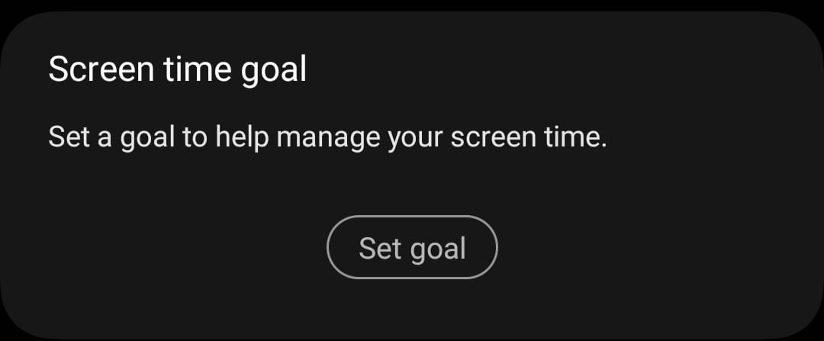
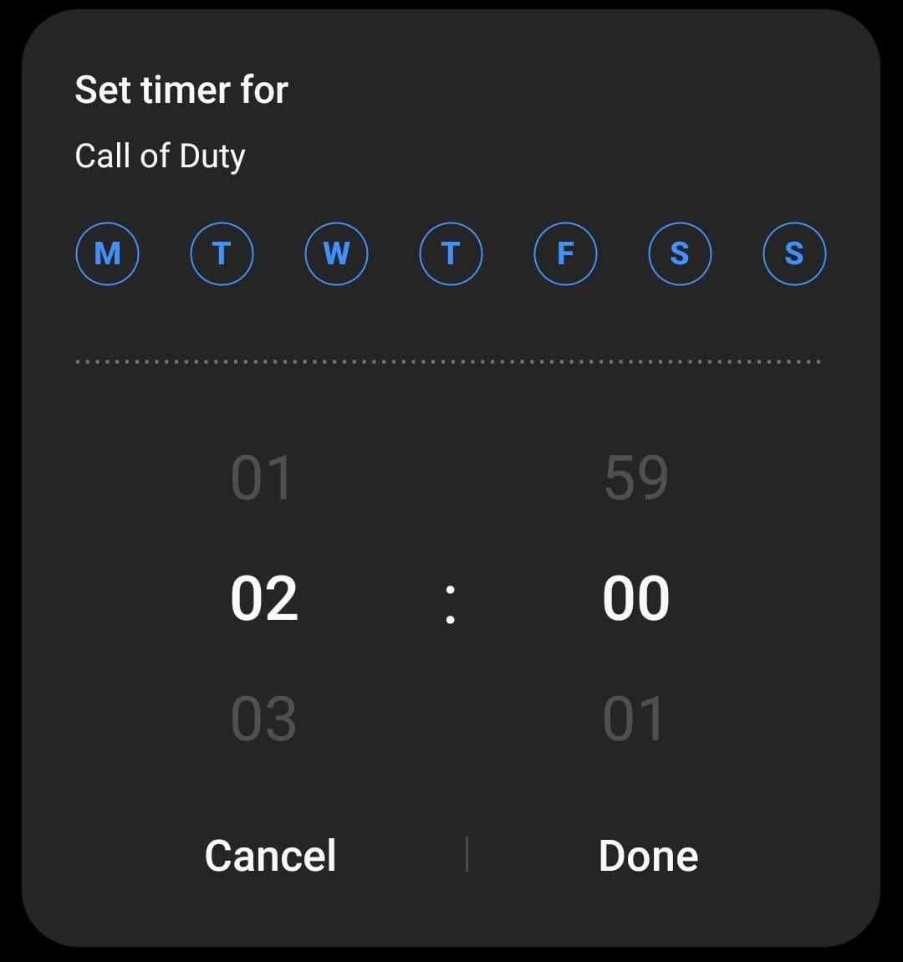
Goal Setting
Total abstinence versus moderate and controlled use
Setting goals – Graded
      Specific
              Measurable
                Achievable
                Relevant
                Time bound

Slide 18

Digital “Nudge”
“use of user-interface design elements to guide people’s behavior in digital choice environment”
Reminder or notification designed to gently guide individuals toward healthier digital usage habits

Slide 19

Cognitive tasks
Degrade interactivity
Lock-out tasks
Break habit of unconscious frequent access
Image retrieved from https://www.pinterest.com/pin/827958712739886710/

Slide 20
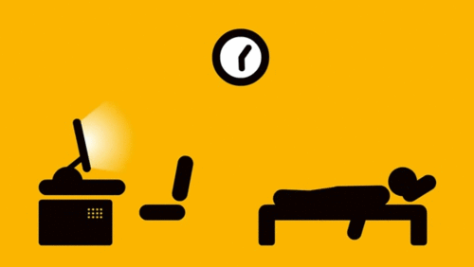
Identify triggers
Image retrieved from: https://www.pinterest.com/pin/399976010627784884/

Slide 21

Behavior Modification
Substitution- engage in alternative activities
Develop new hobbies
Image retrieved from: https://giphy.com/explore/family-sticker

Slide 22

Cognitive Restructuring
Identification of cognitive distortions- irrational and negative patterns of thinking
Put thought “under a microscope”
Challenge the thought
Create a more balanced thought
Image retrieved from: https://giphy.com/explore/restructuring

Slide 23

Mindfullness…
      Regulate addiction related-distressed emotional state
Recognize intrinsic value of life instead of superficial rewards
Full, direct and active awareness of experienced phenomena
Present in the here and now
Image retrieved from: https://technologyformindfulness.com/mindfulness-tips/

Slide 24
Visit a professional?

Slide 25
Cognitive Behavioral Therapy
Problem focussed intervention
Relationship between thoughts, feelings and behaviors
Behavior modification
Cognitive restructuring
Harm reduction therapy

Slide 26
Harm Reduction Therapy
Identify and address personal, situational, psychological, social or occupational issues
May involve
        Treatment for underlying psychopathologies
          Improving interpersonal relationships
          Building social support
        Conflict resolution
        Stress management
Minimise harmful consequences and Prevent relapse

Slide 27
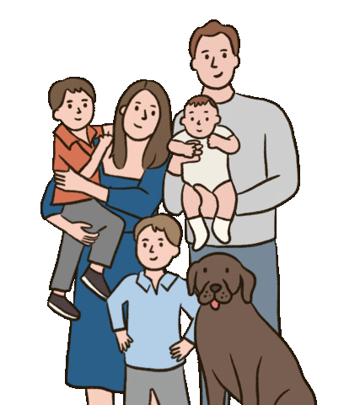
Family Therapy
Identifying unmet psychological needs (belongingness, relatedness, validation)
Strengthening family communication
Fostering positive interpersonal relationships
Providing a safe and enabling digital space for exploration
Modelling appropriate behavior
Image retrieved from: https://giphy.com/explore/family-sticker

Slide 28
Motivational Enhancement Therapy
Collaborative and non-confrontational
Evoke internally motivated change and emphasise of choice
Identify situations, motivations and feelings
Recognize consequences stemming from excessive or compulsive use
Create an individualised treatment plan with attainable goals

Slide 29
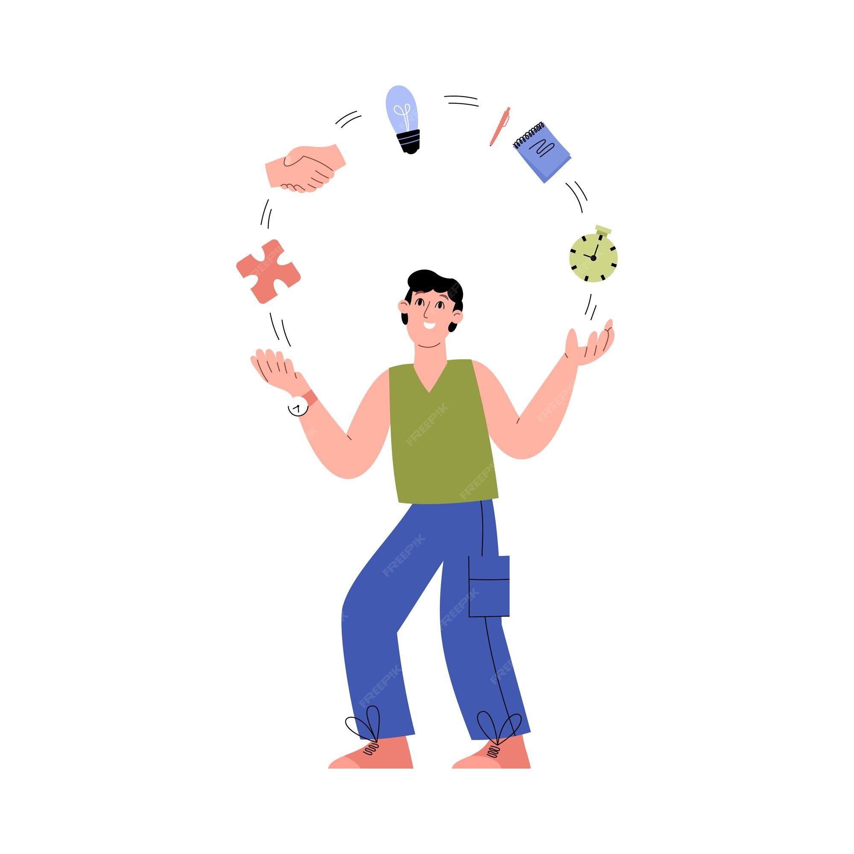
Positive Psychology Interventions
Aimed at promoting self growth and nurturing self
Fostering self-awareness and positive self-concept
Identifying strengths and capabilities (narration)
Fostering a sense of gratitude
Fostering forgiveness
Cherishing and rekindling relationships
Rebuilding hope and aspirations
Image retrieved from: https://www.freepik.com/premium-vector/concept-personal-development-growth-self-improvement_19238357.htm

Slide 30
Thank you!

Slide 31
References
Cemiloglu, D., Almourad, M. B., McAlaney, J., & Ali, R. (2022). Combatting digital addiction: Current approaches and future directions. Technology in Society, 68, 101832. https://doi.org/10.1016/j.techsoc.2021.101832
Chau, C., Tsui, Y. Y., & Cheng, C. (2019). Gamification for Internet Gaming Disorder Prevention: Evaluation of a Wise IT-Use (WIT) Program for Hong Kong Primary Students. Frontiers in Psychology, 10. https://www.frontiersin.org/articles/10.3389/fpsyg.2019.02468
Gao, X.-J., Sun, J.-J., & Xiang, M. (2021). Positive psychological intervention for anxiety, depression and coping in subjects addicted to online games. World Journal of Clinical Cases, 9(14), 3287–3293. https://doi.org/10.12998/wjcc.v9.i14.3287
Khazaei, F., Khazaei, O., & Ghanbari-H., B. (2017). Positive psychology interventions for internet addiction treatment. Computers in Human Behavior, 72, 304–311. https://doi.org/10.1016/j.chb.2017.02.065
Kim, J., Park, J., Lee, H., Ko, M., & Lee, U. (2019). LocknType: Lockout Task Intervention for Discouraging Smartphone App Use. Proceedings of the 2019 CHI Conference on Human Factors in Computing Systems, 1–12. https://doi.org/10.1145/3290605.3300927

Slide 32
Kim, Y.-H., Jeon, J. H., Choe, E. K., Lee, B., Kim, K., & Seo, J. (2016). TimeAware: Leveraging Framing Effects to Enhance Personal Productivity. Proceedings of the 2016 CHI Conference on Human Factors in Computing Systems, 272–283. https://doi.org/10.1145/2858036.2858428
Lan, Y., Ding, J.-E., Li, W., Li, J., Zhang, Y., Liu, M., & Fu, H. (2018). A pilot study of a group mindfulness-based cognitive-behavioral intervention for smartphone addiction among university students. Journal of Behavioral Addictions, 7(4), 1171–1176. https://doi.org/10.1556/2006.7.2018.103
Li, H., & Wang, S. (2013). The role of cognitive distortion in online game addiction among Chinese adolescents. Children and Youth Services Review, 35(9), 1468–1475. https://doi.org/10.1016/j.childyouth.2013.05.021
Liu, Q.-X., Fang, X.-Y., Yan, N., Zhou, Z.-K., Yuan, X.-J., Lan, J., & Liu, C.-Y. (2015). Multi-family group therapy for adolescent Internet addiction: Exploring the underlying mechanisms. Addictive Behaviors, 42, 1–8. https://doi.org/10.1016/j.addbeh.2014.10.021
Löchtefeld, M., Böhmer, M., & Ganev, L. (2013). AppDetox: Helping users with mobile app addiction. Proceedings of the 12th International Conference on Mobile and Ubiquitous Multimedia, 1–2. https://doi.org/10.1145/2541831.2541870
Malak, M. Z. (2017). Internet Addiction and Cognitive Behavioral Therapy. In Cognitive Behavioral Therapy and Clinical Applications. IntechOpen. https://doi.org/10.5772/intechopen.71277

Slide 33
Park, J., Sim, J., Kim, J., Yi, M., & Lee, U. (2018). Interaction Restraint: Enforcing Adaptive Cognitive Tasks to Restrain Problematic User Interaction (p. 6). https://doi.org/10.1145/3170427.3188613
Sei, J., Minai, J., Funato, K., Hara, H., & Ayukawa, M. (2018). Effect of Web-Based Intervention on Internet Addiction among Adolescents: A Quasi-Experimental Trial. Journal of Adolescent Health, 62(2), S126. https://doi.org/10.1016/j.jadohealth.2017.11.256
Sharma, M. K., & Palanichamy, T. S. (2018). Psychosocial interventions for technological addictions. Indian Journal of Psychiatry, 60(Suppl 4), S541–S545. https://doi.org/10.4103/psychiatry.IndianJPsychiatry_40_18
Singh, A. K., & SIngh, P. K. (2019). Digital Addiction: A conceptual overview.
Szász-Janocha, C., Vonderlin, E., & Lindenberg, K. (2020). Treatment outcomes of a CBT-based group intervention for adolescents with Internet use disorders. Journal of Behavioral Addictions, 9(4), 978–989. https://doi.org/10.1556/2006.2020.00089
Zhong, X., Zu, S., Sha, S., Tao, R., Zhao, C., Yang, F., Li, M., & Sha, P. (2011). The Effect of a Family-based Intervention Model On Internet-addicted Chinese Adolescents. Social Behavior and Personality: An International Journal, 39(8), 1021–1034.

